Slide 1
Phase of project Front-end web development

Slide 2
Languages used : HTML & CSS
Patient Version

Slide 3
What can I do As a patient ?
-Login
-Logout
-Make an appointment
-Edit my Information
-View medical history
-View receipt
-Contact with clinic

Slide 4
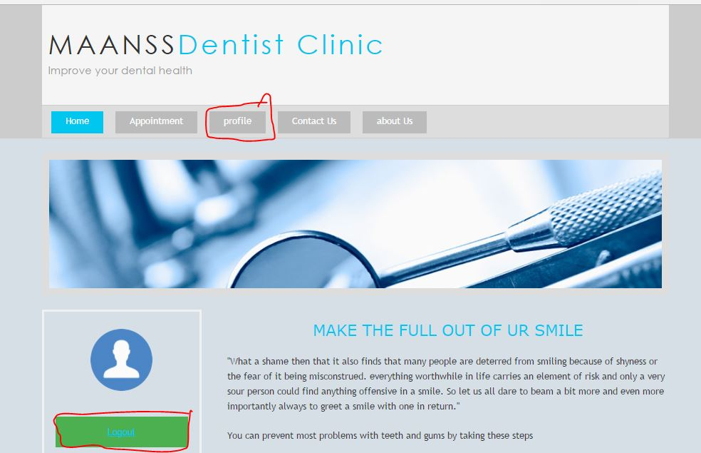
!Profile Icon, it's amazing

Slide 5
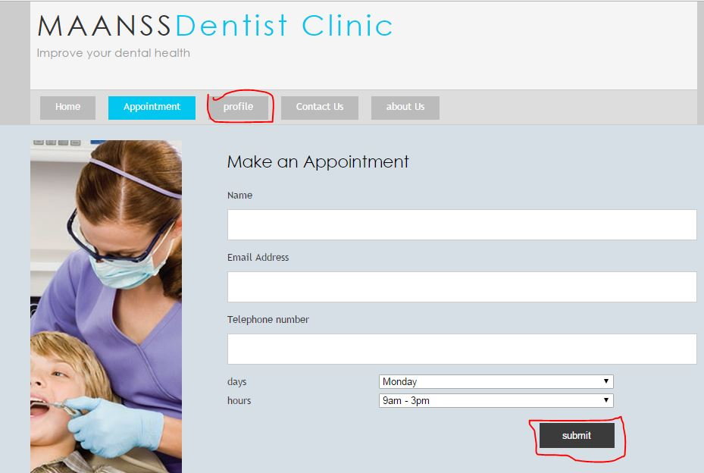
I can appointment

Slide 6
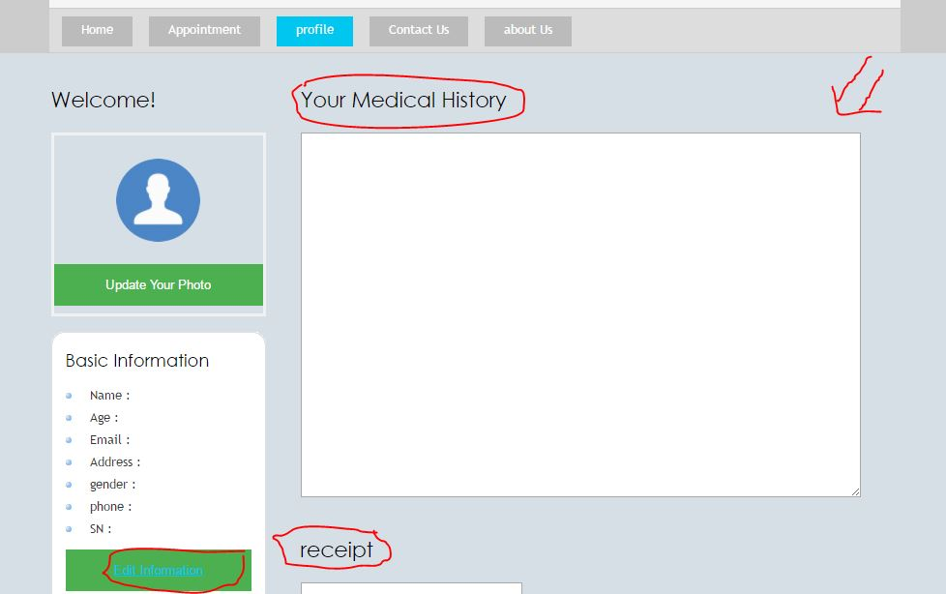
My profile

Slide 7
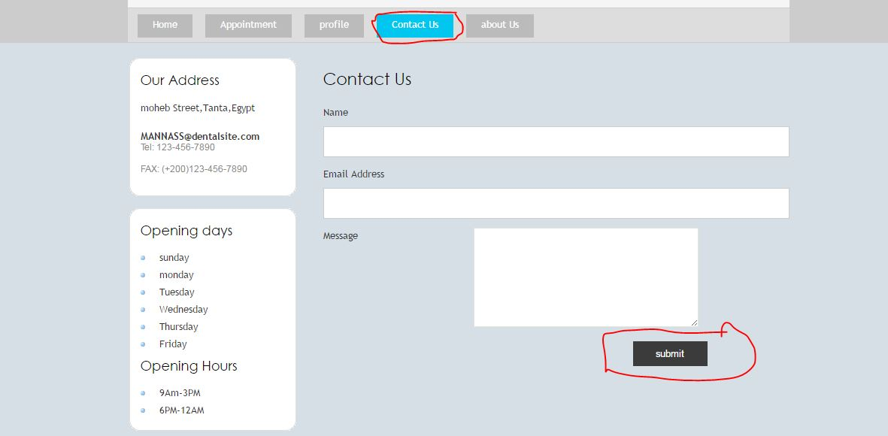
Contact with clinic

